Slide 1
L2# EJBs, Annotations, Servlet contd.
Harpreet Singh
Harpreet.singh@johnabbott.qc.ca

Slide 2
EJBs – session bean
Stateful:
The state of an object consists of the values of its instance variables. In a stateful session bean, the instance variables represent the state of a unique client/bean session. Because the client interacts (“talks”) with its bean, this state is often called the conversational state.
The state is retained for the duration of the client/bean session. If the client removes the bean, the session ends and the state disappears. This transient nature of the state is not a problem, however, because when the conversation between the client and the bean ends, there is no need to retain the state.

Slide 3
EJBs – session bean
Stateless:
A stateless session bean does not maintain a conversational state with the client. When a client invokes the methods of a stateless bean, the bean’s instance variables may contain a state specific to that client but only for the duration of the invocation.
When the method is finished, the client-specific state should not be retained.
Because they can support multiple clients, stateless session beans can offer better scalability for applications that require large numbers of clients.
Typically, an application requires fewer stateless session beans than stateful session beans to support the same number of clients.

Slide 4
EJBs – session bean
Singleton:
A singleton session bean is instantiated once per application and exists for the lifecycle of the application.
Singleton session beans are designed for circumstances in which a single enterprise bean instance is shared across and concurrently accessed by clients.
Singleton session beans maintain their state between client invocations but are not required to maintain their state across server crashes or shutdowns.
Applications that use a singleton session bean may specify that the singleton should be instantiated upon application start up.

Slide 5
EJBs – session bean
Singleton vs Stateless:
Singleton session beans offer similar functionality to stateless session beans but differ from them in that there is only one singleton session bean per application, as opposed to a pool of stateless session beans, any of which may respond to a client request. Like stateless session beans, singleton session beans can implement web service endpoints.

Slide 6
Stateless vs. Stateful
Stateless
no internal state
can be pooled to service multiple client
need not to handle activation and passivation
examples: calculator
Stateful
possess internal state
need to hand activation and passivation
examples: shopping cart

Slide 7
EJBs – transactions
Transactions:
To a user, a transaction is a single change event that either happens or does not happen
To the system implementers, a transaction is a programming style that enables them to code modules that can participate in distributed computations
Ex: transferring money from a checking to a savings bank account
Sounds easy but in a distributed environment need transaction control
Transaction manager – keeps track of the progress of a transaction
Commits or rolls back the ENTIRE transactions which can be updates to multiple database tables in multiple databases...

Slide 8
Container Managed Persistent vs. Bean Managed Persistent
Container Managed
EJB container is responsible for saving and retrieving bean’s state
Independent of data source
Easy to develop
Bean Managed
Entity bean is responsible for saving bean’s state.
Less adaptive than container managed entity bean
persistence need to be hard coded into the bean

Slide 9
When to use session beans
Stateful:
The bean’s state represents the interaction between the bean and a specific client.
The bean needs to hold information about the client across method invocations.
The bean mediates between the client and the other components of the application, presenting a simplified view to the client.
Behind the scenes, the bean manages the work flow of several enterprise beans.

Slide 10
When to use session beans
Stateless:
For improved performance
The bean’s state has no data for a specific client.
In a single method invocation, the bean performs a generic task for all clients.
For example, you might use a stateless session bean to send an email that confirms an online order.
The bean implements a web service.

Slide 11
When to use session beans
Singleton:
State needs to be shared across the application.
A single enterprise bean needs to be accessed by multiple threads concurrently.
The application needs an enterprise bean to perform tasks upon application start up and shutdown.
The bean implements a web service.

Slide 12
Annotations
What are annotations?
@symbol
@override
@Entity
@Stateless etc
Annotations are meta-data(data about data)
Are easy to use
Before annotations xml configuration files were used

Slide 13
Annotations in EJBs
@Stateless – one word for configuring the bean as stateless
@Stateful
@Local – for local bean usage
@remote
@MessageDriven

Slide 14
Annotations today
In Modern programming languages annotations are extensively used
xml configurations are also used for frameworks where initial variables need to be defined
You can define your own annotations

Slide 15
EJBs vs Frameworks
https://zeroturnaround.com/rebellabs/spring-vs-java-ee-survey-results/

Slide 16
Servlets – contd.
Harpreet Singh
Harpreet.singh@johnabbott.qc.ca

Slide 17
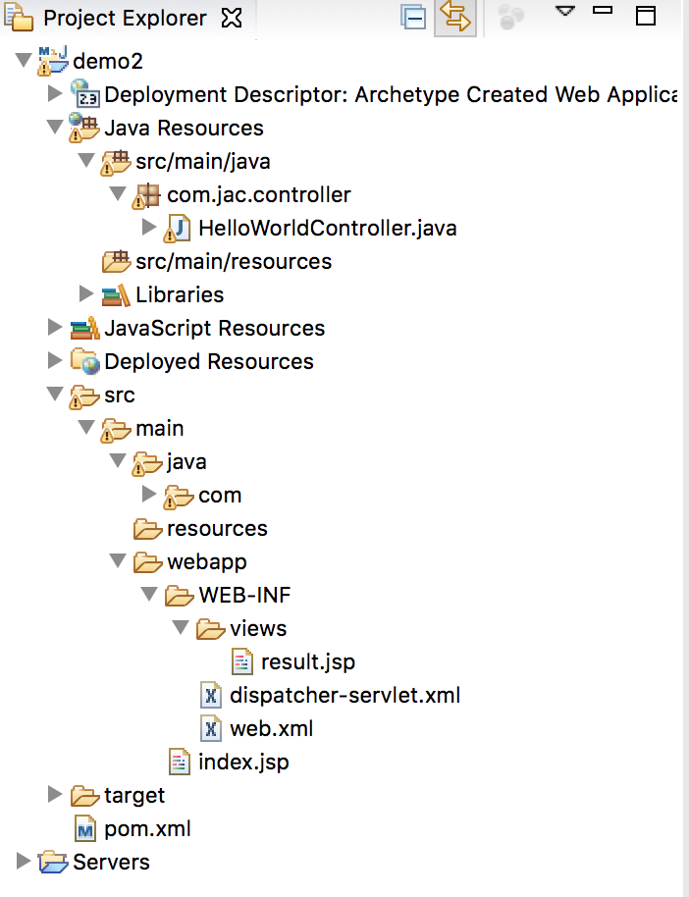
Folder Structure
Name of xml file web.xml is case sensitive
Position of files are important too
Use of package name is recommended
We will study about the files which are shown in this snapshot

Slide 18
Use of web.xml: extended
Lets Practice
Different URL Mapping
Writing multiple Servlets

Slide 19
web.xml
<web-app> represents the whole application.
<servlet> is sub element of <web-app> and represents the servlet.
<servlet-name> is sub element of <servlet> represents the name of the servlet.
<servlet-class> is sub element of <servlet> represents the class of the servlet.
<servlet-mapping> is sub element of <web-app>. It is used to map the servlet.
<url-pattern> is sub element of <servlet-mapping>. This pattern is used at client side to invoke the servlet.

Slide 20
More tags in web.xml
The welcome-file-list element of web-app, is used to define a list of welcome files. Its sub element is welcome-file that is used to define the welcome file.
A welcome file is the file that is invoked automatically by the server.
<web-app…>
….
<welcome-file-list>
<welcome-file>index.jsp</welcome-file>
</welcome-file-list>
<web-app>

Slide 21
More tags in web.xml
To control when the servlet container should load the servlet.
By default: Servlet loaded when the first request arrives
By setting a <load-on-startup> element, you can tell the servlet container to load the servlet as soon as the servlet container starts.
<servlet>
….
<load-on-startup>1</load-on-startup>
</servlet>

Slide 22
Servlets
Form Data in Servlets
GET method
Example: http://www.test.com/hello?key1=value1&key2=value2
Less reliable method
Limit on sending data(1024char/2KB)
Not used for sensitive information like password
POST method
More reliable
Data travels in the Header of the request
Hidden from user
No limit on data

Slide 24
Servlets – contd.
Form Data in Servlets
Define action in the form field of HTML
<form action = ”HelloServlet" method = "GET">
….
<button type=”submit”> Submit </button>
</form>
<form action = ”HelloServlet" method = ”POST">
….
<button type=”submit”> Submit </button>
</form>

Slide 25
Receiving data in Servlet
In case of this URL http://localhost:8080/HelloForm?first_name=ABC&last_name=DEF
We can retrieve the data by using method
request.getParameter("first_name");
request.getParameter(”last_name");
Also,
In HTML/JSP <input type="text" name="testParam">
Java/Servlet String val = request.getParameter("testParam");

Slide 26
Servlets Parameters
An attribute is a server variable that exists within a specified scope i.e.:
application, available for the life of the entire application
session, available for the life of the session
request, only available for the life of the request
page (JSP only), available for the current JSP page only

Slide 27
Extra notes
Harpreet Singh
Harpreet.singh@johnabbott.qc.ca

Slide 28
JAR file download and import steps
Google the JAR file name
Choose mvnrepository.com website if available
Find compatible version(latest version recommended)
Go back to Eclipse
Copy JAR file inside project(usually in lib folder) in eclipse(recommended)
Right click on Project > Properties > Build Path > Library > add JARs
Select JAR file

Slide 29
WAR file and deploying
If project is up and running in Eclipse
Right click on project and export as WAR file
In destination, select where you want to save it
Tick(check) export source files. (If you want to send .java/source files as well)
Now, copy this WAR file and paste in Apache Tomcat’s webapps library
Go to command prompt and go to folder tomcat/bin
Run tomcat by command: startup.bat
Verify if you have folder name as same as WAR file name
Go to any browser and hit URL http://localhost:port/ProjectName/path
Stop tomcat by command: shutdown.bat

Slide 30
Tomcat’s port change
Do not get confused between tomcat running from eclipse and running from local.
If you have error for same ports or tomcat already running on a port, shutdown all the tomcats or restart tomcat service or change tomcat’s port
While deploying tomcat’s port is changed in the xml file
Goto tomcat directory > conf folder
open server.xml
Search "Connector port” for protocol="HTTP..”
Change value in port="8080" by your port number
You may have to change other port numbers as well
Restart tomcat server.

Slide 31
Importing/Exporting project in eclipse
Project can be exported using General/Archive File or General/File System.
Right click on project and select either one.
Archive is compressed zip/tar format whereas File System is folder structure
For Archive File export
Right click on Project > export > General/Archive File
Click next and tick files that needs to be exported
Click Browse and select destination
Select format zip, tar etc
Click Finish
For Archive File import
Right click in empty space> import > “Existing Projects into Workspace”
Click next and select “Select Archive File”
Click Browse and select target file
Confirm project and files and hit Finish

Slide 32
Class work
Harpreet Singh
Harpreet.singh@johnabbott.qc.ca

Slide 33
Servlets Application
Create application in Servlet which takes 2 username and password from user and in Servlet check if username and password are same.
If same – print successful and print username and password
If not – print fail

Slide 34
Servlets Application
Learn new HTML parameters receiving in Servlets
For example:
Radio buttons
List
TextArea
etc

Slide 35
References
Best book on EJBs, Head First EJB by Kathy Sierra & Bert Bates
http://download.oracle.com/otn-pub/jcp/7224-javabeans-1.01-fr-spec-oth-JSpec/beans.101.pdf?AuthParam=1527471400_d99cd50a332d90b7716b67400a868b9b
https://www.slideshare.net/jitenderlodhi/enterprise-java-bean?from_action=save
https://examples.javacodegeeks.com/enterprise-java/ejb3/ejb-tutorial-beginners/

